Slide 1
Experts & Psychological/Psychiatric Evaluations November 2020

Slide 2
Brainstorm:
Why might we want to include an expert in CP cases? What types of issues can they address for us?

Slide 3
Court-Ordered Evaluations
C.G.S. § 46b-124
Follow protocol found in P.B. § 34a-21 and In re David W., 254 Conn. 676 (2000)
Rules around sharing with other providers/witnesses

Slide 4
Relevant Case Law
Parties have the right to refuse to participate in court-ordered evaluations.
If a parent’s consent to participate is based upon an understanding that it would only be used by those involved in the hearing, then the evaluation must not be used beyond that.
Parents should be provided a hearing in which the court can determine what was explained to them in order to obtain their informed consent to the evaluation.
In re Jacklyn H., 162 Conn. App. 811 (2016)

Slide 5
Independent Evaluations
Request from OCPD
Need permission to share court documents
In re Jorden R, 293 Conn. 539 (2009)
Failure to follow proper confidentiality procedures fairly resulted in preclusion of independent expert’s testimony.

Slide 6
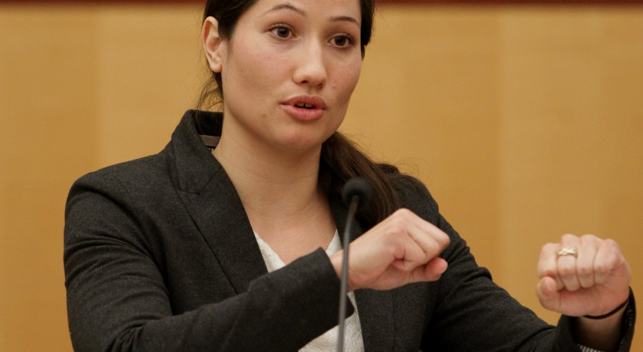
Experts and Rules of Evidence
CT Code of Evidence § 7-2
To testify in the form of an opinion:
Expert must be qualified by knowledge, skill, experience, training, or education.
Testimony must assist the Court in understanding the evidence or determining a fact in issue.

Slide 7
Experts and Rules of Evidence
CT Code of Evidence § 7-3
Experts are not allowed to offer opinion as to ultimate issue to be decided by the Court, except “where trier of fact needs expert assistance in deciding issue.”
See In re: Melody L, et al., 290 Conn. 131, 160 (2009)

Slide 8
Experts and Rules of Evidence
CT Code of Evidence § 7-4(a)
Use of opinions – sufficient facts necessary
CT Code of Evidence § 7-4(b)
Reliance on hearsay & articles okay
Facts need not be admissible if of type customarily relied on by experts in the field
Facts relied upon are not substantive evidence themselves, unless otherwise admissible
CT Code of Evidence § 7-4(c)
Use of hypotheticals

Slide 9
Experts: Objections
CT Code of Evidence § 7-2
Can only testify as to opinion concerning scientific, technical, or other specialized knowledge
Example: Clinician cannot testify to ultimate conclusion re: whether child should be removed from parent or rights should be terminated …
These are not “clinical” or “scientific” determinations.

Slide 10
Experts: Cross Examination Tips
Question Qualifications
Knowledge, skill, experience, training, education
Pay attention to what offered as expert in, e.g. Bone fractures? Child abuse?
Use own expert to ask for assistance with how to cross examine opposing expert.

Slide 11
Experts: Bias/Credibility
Check expert’s name through:
LEXIS and Westlaw, to see how many times testified for state
MedLine, to get articles and see if board-certified

Slide 12
Experts: Process and Methodology
What did expert rely on? Did s/he have enough information to make a reliable determination?
LINK records, investigation protocol, police records, school records, medical records, SDM, MDE, etc.
Length of interview/evaluation?
Setting for evaluation/interview?
CAUTION: With court-appointed evaluators, counsel has opportunity to submit questions to evaluator, which may limit objections later.

Slide 13
Documents
Get the CV of expert — exhibit or hearsay?
Should you stipulate to expertise?
Prepare questions necessary to offer as expert
Enter report into evidence

Slide 14
Questions
Martha Stone, Esq
Center for Children’s Advocacy
mstone@cca-ct.org
860.570.5327
Thomas A. Esposito, Esq.
Welty Esposito & Wieler, LLC
tae@wewlaw.net
203.781.0877
S

