Slide 1
Protecting Children With Disabilities
Bonnie Roswig, Esq.
Senior Staff Attorney, Medical-Legal Partnership Project
Center for Children’s Advocacy

Slide 2
Case Study: John
Age: 16
Status: In and out of Juvenile Detention
Issue: Probation violation - flight
Health Care Status: Type 1 diabetic (self administers)
Family Status: Supportive single father
cca-ct.org

Slide 3
Residential Placement Opportunity – Connecticut Junior Republic (CJR)
Universal Support
John
Father
Probation Officer
Health Care Provider
cca-ct.org

Slide 4
Roadblock
CJR Refusal to Accept
Reason: Diagnosis - Type 1 Diabetes
Excuse:
Nurse only on duty 7 am - 2 pm
No diabetic residents unless using insulin pump
Required “proof” of successful use of pump for 2 months
cca-ct.org

Slide 5
Americans with Disabilities Act (ADA)
Title ll
No qualified individual shall, on the basis of disability,
be excluded from participation in or be denied the benefits
of the services, programs, or activities of a public entity,
or be subject to discrimination by any public entity.
cca-ct.org

Slide 6
Americans with Disabilities Act (ADA)
Title lll
No individual shall be discriminated against on the basis
of disability in the full and equal enjoyment of the goods,
services, facilities, privileges, advantages of any place
of public accommodation by any private entity.
cca-ct.org

Slide 7
ADA Title II Protecting the Rights of Children
Programs operated by municipality
Cannot exclude children exclusively because of diagnosis
Cannot exclude children who require medication
cca-ct.org

Slide 8
ADA Title III Protecting the Rights of Children
Programs operated by private entities
Cannot exclude children because of diagnosis
Cannot exclude children who require medication
cca-ct.org

Slide 9
ADA Requirements
Reasonable modification to policies, practices, procedures
Objective
Avoid denial of access to programs and services to
children with disabilities
Obligation
Integrate children, parents and guardians with disabilities
cca-ct.org

Slide 10
Program Participation and Parental Oversight
Program cannot require parents to provide oversight
Cannot insist that parents oversee medication
Cannot insist that parents physically stay at site
Cannot insist that parent pay for staff training
cca-ct.org

Slide 11
Reasonable Modification
Individualized Assessment
Disabilities are unique to child
Impact is unique to child
Modification based on specific needs of child
cca-ct.org

Slide 12
Individualized Assessment
Meeting the Inclusion Requirement
Individualized Assessment
Input from parents and educators
Input from health care team
cca-ct.org

Slide 13
Children Requiring Medication
Reasonable accommodation
Medical Plan from health care provider
Training for Staff (paid by facility, not by parents)
Blanket denial to administer medication violates ADA
cca-ct.org

Slide 14
Children with Mental Health Challenges
Diagnosis does not determine participation
Blanket exclusion is illegal
Accommodation attempts required
cca-ct.org

Slide 15
Children with Cognitive Delays
Cognitive delay does not equal exclusion from program
Modification Requirement: reasonable steps to integrate child into all activities
cca-ct.org

Slide 16
Discrimination
Ignorance: Medical condition
Ignorance: Law
Ignorance: Liability
cca-ct.org

Slide 17
Not the Right Placement
Limited exceptions to ADA
Fundamental alteration of program
Undue burden
Direct threat to health and safety of others
cca-ct.org

Slide 18
Fundamental Alteration Not Required
Not required to abandon mission or offer fundamental program alteration
Exceptions: specific training programs
Example: combat karate program not required to change bodily contact component of program
cca-ct.org

Slide 19
Undue Burden
Significant difficulty or expense
Nature and cost
Financial resources of program
Financial resources of parent company
Number of employees
Impact on total operation
cca-ct.org

Slide 20
Direct Threat to Health and Safety of Others
Individualized Determination
Based on current medical knowledge or best available objective evidence to ascertain nature, duration and severity of risk, probability that injury will occur
Consideration of particular activity and actual abilities of child
cca-ct.org

Slide 21
Parents in Child Protection System
Technical Assistance – HHS/DOJ
Protecting the Rights of Parents and Prospective Parents with Disabilities
www.ada.gov/doj_hhs_ta/child_welfare_ta.html
cca-ct.org

Slide 22
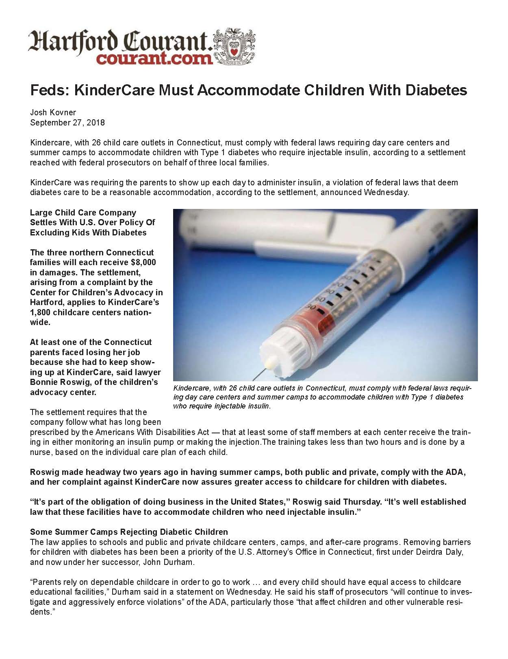
Cost of Non-Compliance
Legal action: KinderCare
Monetary sanctions
Press
Hartford Courant September 27, 2018
https://cca-ct.org/wp-content/uploads/2018/09/ Courant-KinderCare-Kovner-9-27-18.pdf
cca-ct.org

Slide 23
Questions and Information
Bonnie Roswig, Esq.
broswig@cca-ct.org
860-545-8581
cca-ct.org

