Slide 1
“That’s So Gay!”
Cultivating Safe, Inclusive, and Affirming Spaces for ALL Students
Jeff Bianco MEd Curriculum and Instruction Co-chair
GLSEN Connecticut

Slide 2
GLSEN is the leading national education organization focused on ensuring safe schools for all students.

Slide 3
All students deserve a safe,
supportive school environment
free of bias-based behavior.
Addressing anti-LGBTQ+ bias in schools
makes schools safer for ALL students
regardless of sexual orientation
and gender identity or expression.

Slide 4
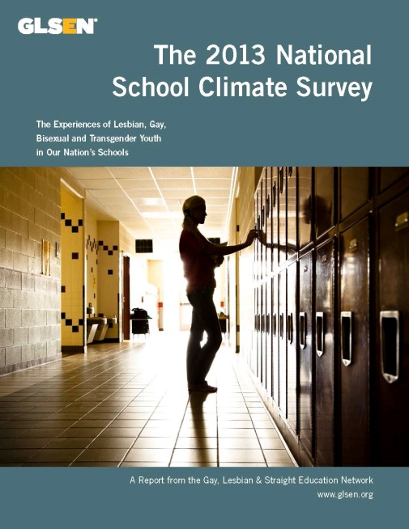
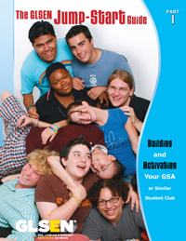
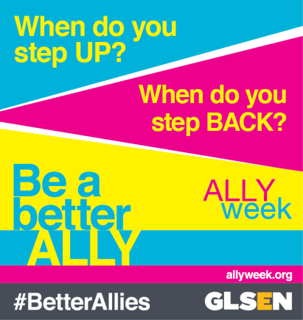
GLSEN Resources

Slide 5
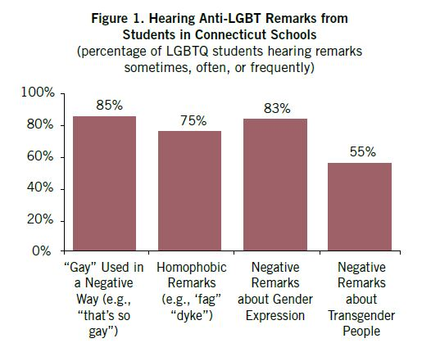
CT Snapshot 2015: Hearing Anti-LGBT Remarks

Slide 6
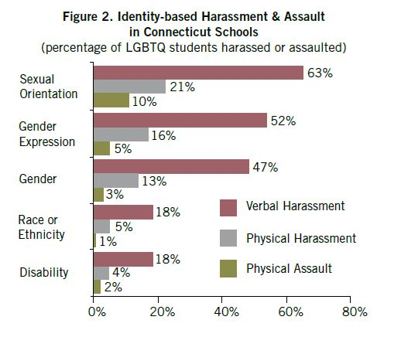
CT Snapshot 2015: Harassment and Assault

Slide 7
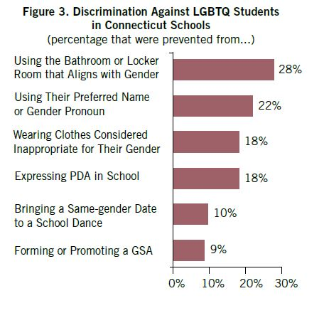
CT Snapshot 2015: Anti-LGBT Discrimination

Slide 8
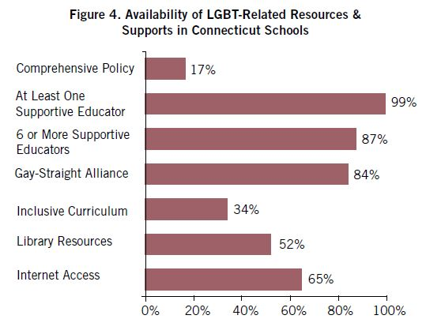
CT Snapshot 2015: LGBT-Related Resources/Supports

Slide 9
Students who experienced high levels of harassment and assault had poorer educational outcomes.
↓ Educational aspirations
↓ School belonging
Victimization
↓ Academic achievement
↑ Missing
school

Slide 10
Students who experienced high levels of harassment and assault had lower psychological well-being.
↑ Depression
Victimization
↑ Anxiety
↓ Self-Esteem

Slide 11
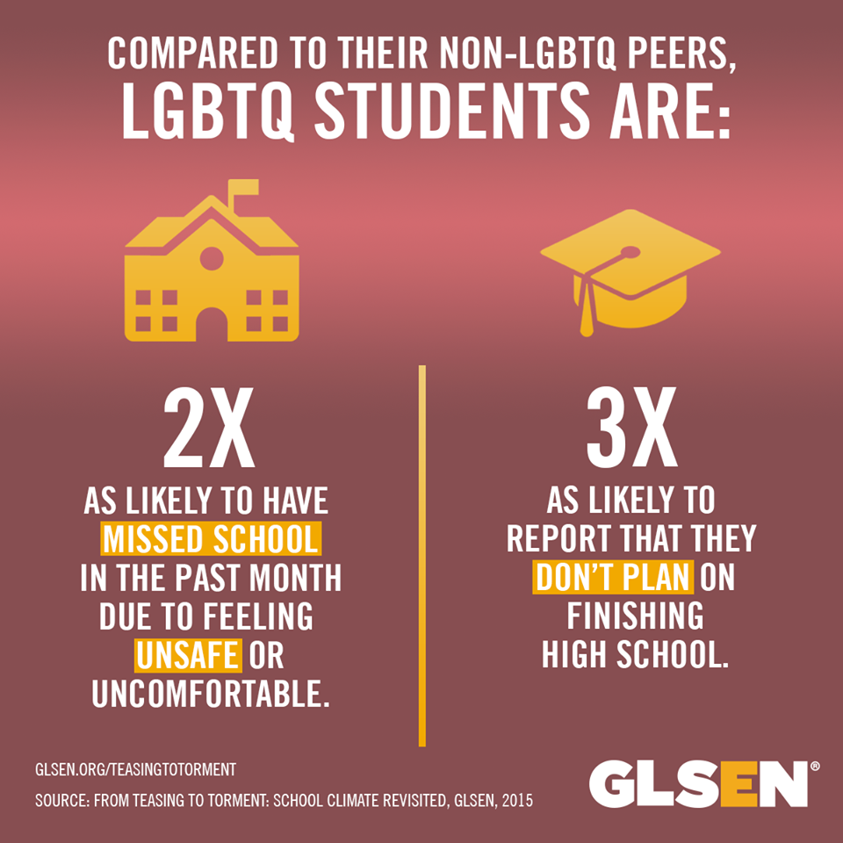

Slide 12
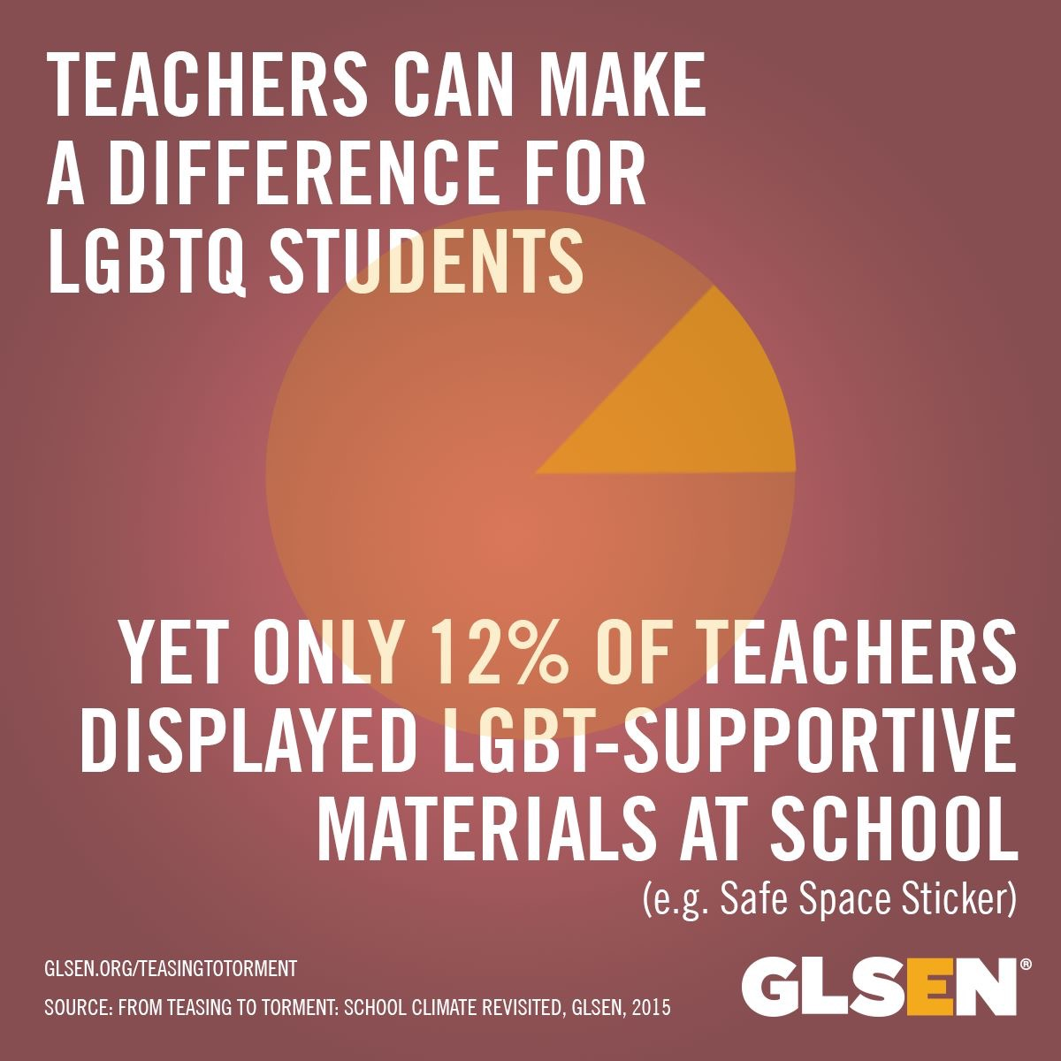

Slide 14
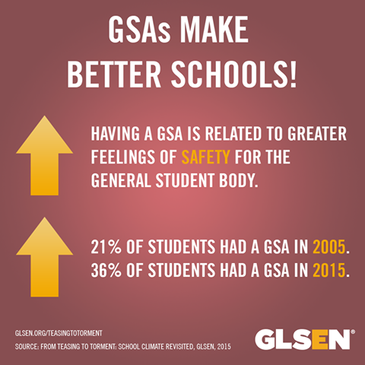

Slide 15
Evidence-Based Interventions
• Enumerated Policies
Implement comprehensive anti-bullying policy that includes protections based on sexual orientation and gender identity/expression among a list of enumerated categories.
• Staff Development
Staff trainings on how to address anti-LGBT bullying.
• Student Support
Support for student interventions such as GSA student clubs and participation in events such as the Day of Silence.
• Inclusive Curriculum
Positive representations of LGBT people, history, and events in school curriculum.

Slide 16
Safe Spaces Do NOT Silence!
LGBTQ students have rights- just like any other student in your school.
HARASSMENT: If a student is being harassed, or witness harassment, the student should report it to the principal, a counselor or other official immediately, and keep notes of all incidents reported.
PRIVACY: Teachers and other school officials do NOT have the right to “out” students without their permission or use their gender and/or sexual identity to manipulate students in any way.

Slide 17
Safe Spaces Do NOT Confine!
FREEDOM OF SPEECH: If students go to a public school, students have a constitutional right to be out of the closet and express their opinions and the full range of their identity.
GAY-STRAIGHT ALLIANCES: According to the Federal Equal Access Act, public high schools that allow students to form non-curricular clubs must also allow students to create GSAs.
PROM: Public schools cannot stop students from bringing their same-sex date to prom or other school functions. Federal law protects this as freedom of expression based on gender.

Slide 18
What Can You Do?
Talk with your children/family, teachers, counselors, social workers, and administrators about bullying.
When you see mean intervene! Interrupt, confront or react to all LGBT myths, jokes, slurs, stereotypes, etc.
Use inclusive language (i.e. respect pronouns).
Report repeated episodes of bullying to your Safe Schools Climate Specialist/Title IX Coordinator.
Get involved with GLSEN Connecticut and use/share our programs and resources!

Slide 19
GLSEN Connecticut
SHINE Team
Volunteer Opportunities
Trainings/Presentations/Speakers
Financial Support for GSAs
Safe Schools/GSA Summits
Monthly Chapter Meetings
Facebook/Twitter

Slide 20
GLSEN Connecticut Contact Info.
Website: glsen.org/connecticut
Email: connecticut@chapters.glsen.org
Facebook: facebook.com/GLSENCT
Twitter: twitter.com/GLSENCT
For more info and resources, visit
www.glsen.org

