Slide 1
Working with Transgender & Gender Expansive Individuals
Health Considerations
Christy Olezeski, PhD

Slide 2

Yale Gender Program
1 Long Wharf Drive, 2nd Floor
New Haven, CT 06511
Appointments: 203-785-4081
Interdisciplinary center
Endocrinology
Mental Health
Primary Care
Plastic Surgery
Urology
Gynecology
Repro Endo
Children, adolescents and young adults between the age of 3-25 years
Director:
Christy Olezeski, PhD
Medical Director:
Susan D. Boulware, MD
Endocrinology:
Anisha Patel, DO
Stuart Weinzimer, MD
Psychiatry:
Timothy Van Deusen, MD
Gordon Weiss, MD
Legal:
Alice Rosenthal, JD
Medical Ethicist:
David Hersh, MD

Slide 3
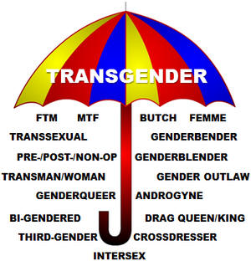
Cis Gender
Courtesy of PFLAG of Phoenix
Notes:
What is included under the transgener umbrella. Usually see as trans* to be inclusive of all. Understanding of Cis and Transgender

Slide 4




Transitions
Social (pronouns, name, dress)
Hormonal
Surgical
Notes:
Not all individuals who identify as trans want to transition to the opposite sex, fully. Some choose to use opposite pronouns and adopt the opposite style of dress or interacting. Some choose to use hormone replacement therapy, and a smaller proportion choose surgical options.
It is also important to think about the idea of someone being “born into the wrong body.” Not all trans individuals see this as an appropriate label, as this is victimizing. It implies something was beyond their control. Whereas, if it is stated as a mismatch between biology and how view self, this is seen as a decision that a person has control over. Noting the incongruence and doing something about it.

Slide 5
Diagnosis of Gender Dysphoria

Slide 6
Gender Dysphoria
A marked incongruence between one’s experienced/expressed gender and primary and/or secondary sex characteristics
A strong desire to be rid of one’s primary and/or secondary sex characteristics
A strong desire for the primary and/or secondary sex characteristics of the other gender
A strong desire to be of the other gender
A strong desire to be treated as the other gender
A strong conviction that one has the typical feelings and reactions of the other gender

Slide 7
Presentation in Children
A strong desire to be of the other gender or an insistence that one is the other gender
A strong preference for wearing clothes typical of the opposite gender
A strong preference for cross-gender roles in make-believe play or fantasy play
A strong preference for the toys, games or activities stereotypically used or engaged in by the other gender
A strong preference for playmates of the other gender
A strong rejection of toys, games and activities typical of one’s assigned gender
A strong dislike of one’s sexual anatomy
A strong desire for the physical sex characteristics that match one’s experienced gender

Slide 8
Transphobia and
Mental Health

Slide 9
Mental Health Outcomes
High Comorbidity with:
  Depression
  Anxiety
  Eating Disorders
  Victimization
  NSSI/SA
  Inpatient Hospitalization
  Substance Use/Binge Drinking
  Cigarette Use
  HIV
Skagenberg, Davidson & Carmichael, 2013; Zucker & Bradley, 2005; Wallen Swaab & Cohen-Kettenis, 2007; Reisner, Vetters, Leclerc, Zaslow, Wolfrum, Shumer, & Mimiaga, 2015; Birkett, Newcomb & Mustanski, 2015; Simons, Schrager, Clark, Belzer & Olson, 2013

Slide 10
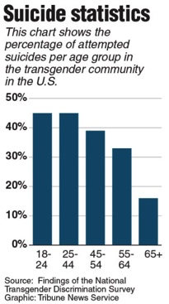
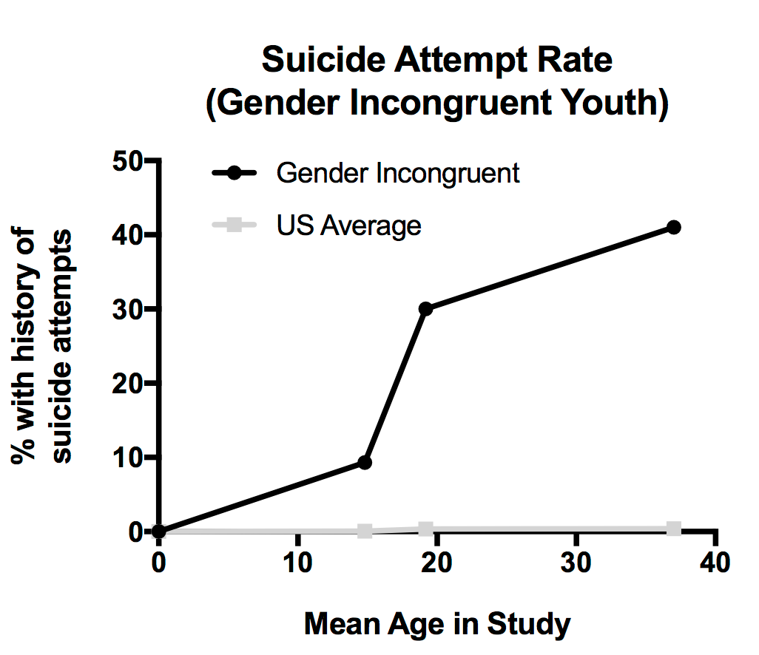
Suicide Attempts

Slide 11
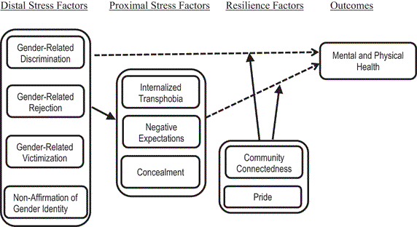
Gender Minority Stress Model
Minority stress and resilience factors in transgender and gender non-conforming people. Dashed line indicates inverse relationships.
Testa, R. J., Habarth, J., Peta, J., Balsam, K., & Bockting, W. (2015). Development of the Gender Minority Stress and Resilience Measure. Psychology of Sexual Orientation and Gender Diversity, 2(1), 65-77. http://dx.doi.org/10.1037/sgd0000081

Slide 12
How are trans* individuals treated in the community?

Slide 13
US Transgender Survey 2010/2015
6,450 complete surveys 76%W, 5%B, 5%L, 2%A
  27,715 respondents
  62%W, 13%B, 17%L, 5%A
50% had to educate providers (24%)
19% were refused medical treatment (8%)
28% verbally harassed in medical setting (6%)
2% physically attacked in medical office (1%)
28% postponed/avoided treatment (23%)
4X risk HIV (5X)
26% used AOD to cope (29%)
41% attempted suicide (vs. 4.6% US pop) (40%; 7% in previous year)
http://www.thetaskforce.org/static_html/downloads/resources_and_tools/ntds_report_on_health.pdf
Notes:
Victimization, non-affirmation, rejection, discrimination

Slide 14
US Transgender Survey
2015 Connecticut Report
N=319
23% fired, denied position or promotion
  9% verbally harassed
  1% physically or sexually assaulted
29% experienced negative tx in medical setting
  20% did not see Dr. due to fear
17% housing discrimination
12% denied equal tx in public spaces
  20% verbally harassed
54% avoided public restrooms
  11% verbally harassed
10% were subjected to reparative therapy
http://www.transequality.org/sites/default/files/docs/usts/USTSCTStateReport%281017%29.pdf
Notes:
Again, rejection, discrimination victimization non-affirmation.

Slide 15
Healthcare Gaps for Transgender Adults
High rates of HIV MtF reported (10-52%) (FtM 0-11%)
  high rates non-condom intercourse
Higher HIV rates: AA, sex work, illicit drug use and experiencing gender-based violence
High rates of tobacco
Trans men of color less apt to access primary care vs white trans men
Barriers to care: stigma, unaware of resources, exclusion from research trials, mistrust of scientific community, perceived side effects of tx
High numbers of trans men not getting pap exams (~31 %) – due to discomfort with anatomy, providers not knowing how to provide care
  Decreased screening, increased risk for cervical cancer
No data on chest screenings, colorectal screenings
Edmiston, E. K., Donald, C. A., Sattler, A. R., Peebles, J. K., Ehrenfeld, J. M., & Eckstrand, K. L. (2016). Opportunities and Gaps in Primary Care Preventative Health Services for Transgender Patients: A Systematic Review. Transgender Health, 1(1), 216-230.
Notes:
(41 studies) Most studies conducted in urban areas,
Note that some studies use term transgender to describe cisgender LGB individuals – need to examine language used
Edmiston, Donald, Sattler, Peebles, Ehrenfeld & Eckstrand (2016)

Slide 16
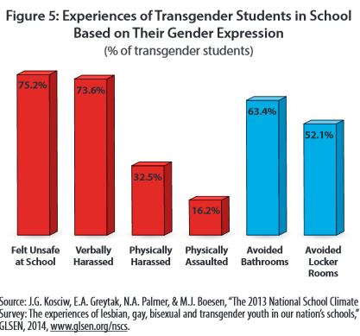
National School Climate Survey 2013
7,898 students
  2,770 districts
  68% white
  44% cis-female
  59% LGB
15% dropout

Slide 17


Family Acceptance Project
Without family support:
More than 8X as likely to have attempted suicide
Nearly 6X as likely to report high levels of depression
More than 3X as likely to use illegal drugs
More than 3 X as likely to be at high risk for HIV and sexually transmitted diseases

Slide 18
Minority Stress Model
✖
✖
Burdensome?
Minority stress and resilience factors in transgender and gender non-conforming people. Dashed line indicates inverse relationships.
Testa, R. J., Habarth, J., Peta, J., Balsam, K., & Bockting, W. (2015). Development of the Gender Minority Stress and Resilience Measure. Psychology of Sexual Orientation and Gender Diversity, 2(1), 65-77. http://dx.doi.org/10.1037/sgd0000081

Slide 19
The Role of Treatment Providers

Slide 20
Types of Treatment
Disconfirming/conversion therapy
Wait and See
Affirming

Slide 21
Affirming Stance
GV is not a disorder
Gender presentations are diverse
Gender is an interplay between biology, development, socialization and culture
Gender is fluid and not binary
Mental health concerns stem from negative cultural reactions and are not within the person
Connections to the community are very helpful

Slide 22

Role of Mental Health Providers
Assess GD
Provide family counseling/support (re: acceptance/secrecy)
Assess co-morbid disorders
Refer for physical interventions (after documentation)
Educate/advocate in community
Refer to peer/family support networks
Leelah's Coverage

Slide 23

Standards of Care
Interdisciplinary Team
Assessment
  Impact of stigma
  Availability of support
  Ability to consent
Discuss Options – risks/benefits
Fertility
Assess co-existing MH concerns
  Need to be stabilized
Medical follow up every 3-6 months
Surgery after 1 year hormone treatment, social transition
  Legal age of majority?
http://www.wpath.org/site_page.cfm?pk_association_webpage_menu=1351
https://academic.oup.com/jcem/article-lookup/doi/10.1210/jc.2009-0345

Slide 24

Treatment – Pre-Pubescent Children
Assessment and exploration
  Support
  Watchful exploration
  Social transition
Assessment of safety
Family/community support
Understanding of flexible stance
Olson, K. R., Durwood, L., DeMeules, M., & McLaughlin, K. A. (2016). Mental health of transgender children who are supported in their identities. Pediatrics, 1-8.
Durwood, L., McLaughlin, K. A., & Olson, K. R. (2017). Mental health and self-worth in socially transitioned transgender youth. Journal of the American Academy of Child & Adolescent Psychiatry, 56(2), 116-123.

Slide 25
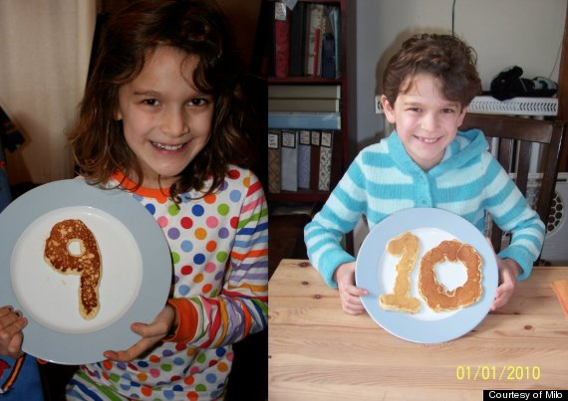
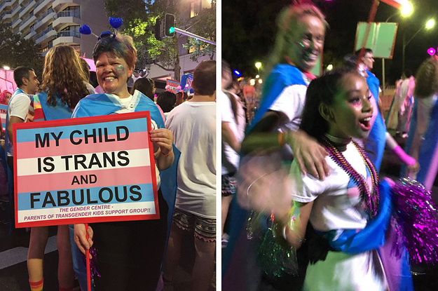
Pubescent Children
Onset of puberty might increase GD
  Puberty suppression
If not, support GNC behaviors

Slide 26
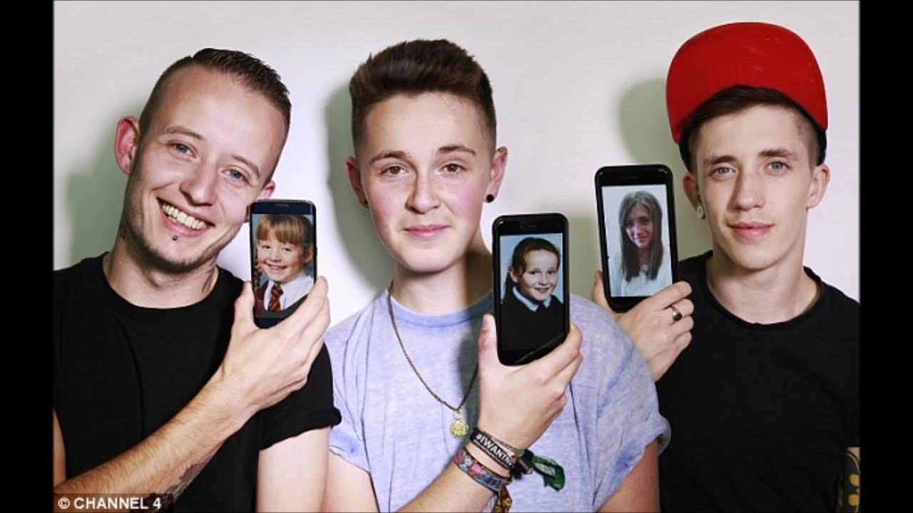
Persistence into Adulthood
Insistent
Persistent
Consistent
Meet GD criteria
Early onset, later referral age
Body dysphoria
Level of social transition
Notes:
Continue to assess risks and benefits of treatment, support in own journey. This can be from binary perspective.

Slide 27
Common Parental Reactions
Grief
  Loss of internalized (hetero, cis gender) story of their child
Helplessness and Fear:
  Loneliness, violence – protectiveness
Own “coming out”
  Moving from privilege to minority status. Feelings of failure, shame, stigma
Complications
  Marital problems, cultural conflict

Slide 28
MH Work with Adults
Assessment
  Impact of stigma
  Availability of support
Discuss Options
Assess co-existing MH concerns
  Need to be stabilized

Slide 29
Evaluation
Hormonal manipulation
  Dx GD
  Tanner 2
  “Adequate” psychological and social support
  “Understanding of expected outcomes of treatment”
  Medical/Social risks & benefits of treatment
  What about cognitive/developmental limitations?

Slide 30
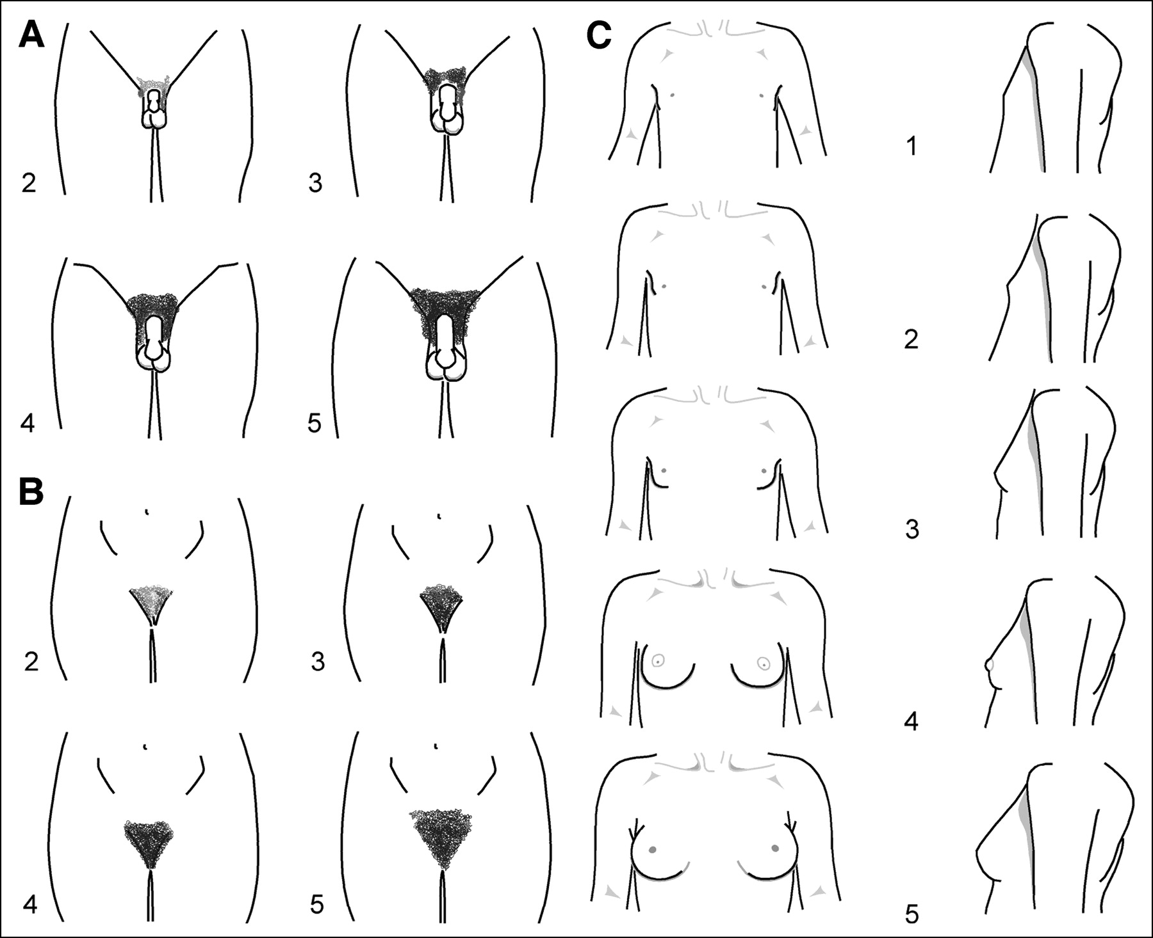
Assent with Delays
Use drawings
  Anatomy of typical male and female puberty changes (risks and benefits of suppression)
  What growth looks like on cross hormones
  What will happen to fertility

Slide 31
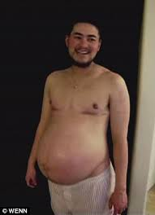
Language
Intake forms/agency forms
  Sex assigned at birth
  Gender identity
  Preferred name, pronoun
Gendered terms “handsome,” “pretty”
How do your partners identify?
When in doubt, ask!

Slide 32



Environment
Gender neutral bathrooms
Gender neutral magazines/photos
LGBT-friendly symbols
LGBT health brochures
Non-discrimination statement

Slide 33
Take Home Messages
Use appropriate terminology
Allow individuals to express their gender identity
Use preferred name and pronoun
Treat information as confidential
Protect trans* individuals from physical and emotional abuse
Make sure treatment is with a trained, affirmative provider
Make room assignments/decisions on individual basis
Avoid assumptions

Slide 34




Organizations
WPATH
Gender Spectrum
Trans-Youth Project
Family Acceptance Project
The TaskForce.org
Human Rights Campaign
The Trevor Project
National Center for Transgender Equality

Slide 35
Do your business/
Mind your business

