Slide 1
Helping Low-Income Families Keep the Power On Utility Clinic Training for Volunteers
Center for Children’s Advocacy
Medical Legal Partnership Project
kidscounsel.org/mlpp

Slide 2
Utility Clinic Goals
1. Maintain Utility Service
2. Budget Counseling
3. Educate and Support Clients
kidscounsel.org/mlpp

Slide 4
Connecticut Law Protects Utility Service
kidscounsel.org/mlpp

Slide 5
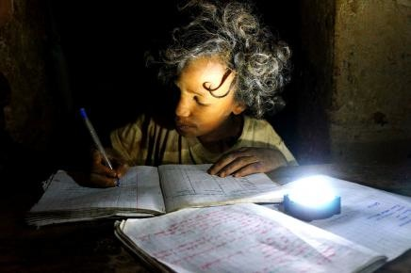
Winter or “Hardship” Protection
Electric Service
Protected Nov 1- May 1 regardless of arrearage
kidscounsel.org/mlpp
Notes:
Describe the electric and natural gas statutes.
Why families might use this opportunity to divert funds they should spend on utilities.
Debt accumulates and on May 1 it may be too late.

Slide 6
Winter or “Hardship” Protection
Gas
If service is on Protected Nov 1- May 1
If service was terminated Client must pay $100 or 20% of balance for reinstatement
kidscounsel.org/mlpp

Slide 8
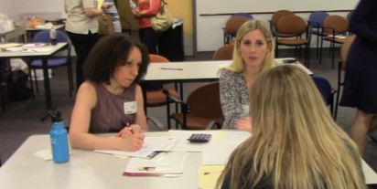
Working with the Client
kidscounsel.org/mlpp

Slide 10
Greet the Client
Introduce yourself
Set out clinic goals and schedule
Discuss utility arrearage
Obtain demographic information
Discuss household budget
Offer cost-saving tips
Meet with Utility Company
kidscounsel.org/mlpp

Slide 12
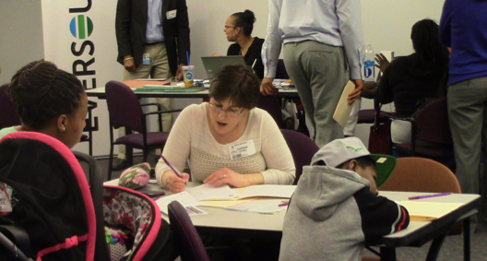
Collecting Information
Demographic information used by
Utility Company
Center for Children’s Advocacy
Remember to ask:
How did you learn
about this clinic?
kidscounsel.org/mlpp

Slide 13
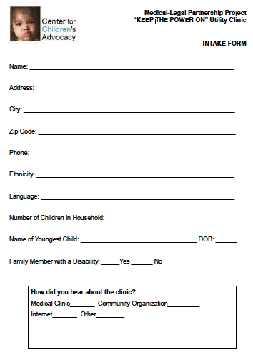
Intake Form
kidscounsel.org/mlpp

Slide 14
Medical Protection
Life threatening condition
Physician must verify in writing
kidscounsel.org/mlpp

Slide 15
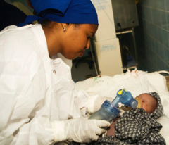
Infant Protection
Infant under 24 months
Point of hospital discharge
Absence of heat or light affects infant’s “health and well-being”
kidscounsel.org/mlpp
Notes:
Vagueness of “life-threatening”
-Examples: nebulizer, insulin, etc.
Uncomfortable position for medical professionals
Infant protection- Rhode Island/MA Infant Protection- child under 2, utilities cannot be shut off
Tried in CT, compromise was CT Infant Protection- child under 2 has been in hospital, discharged with notes saying the child needs heat and lights, then doctor can sign form

Slide 16
Budget Counseling
1. Discuss current budget
2. Develop aspirational budget
kidscounsel.org/mlpp

Slide 17
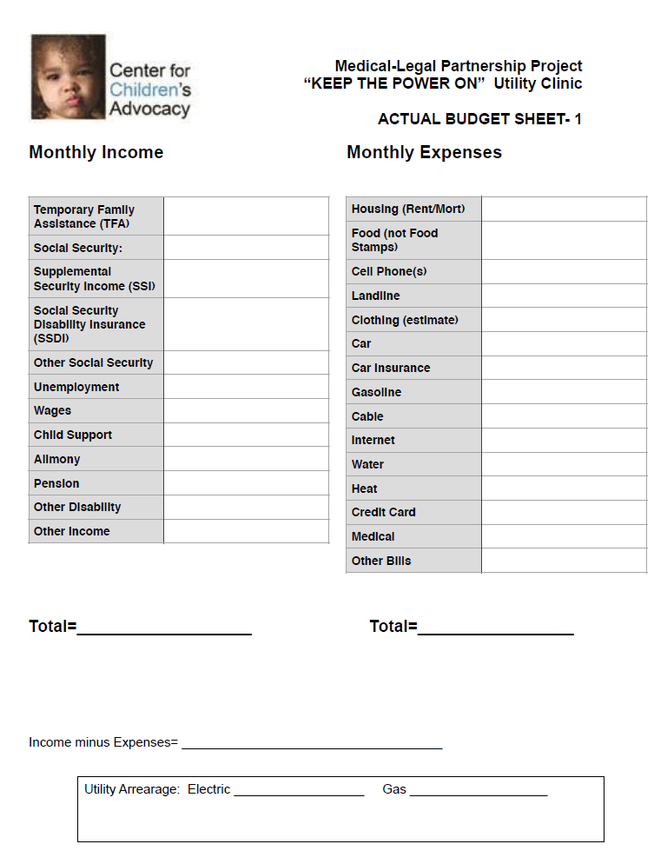
Budget Sheet 1
Actual Budget
kidscounsel.org/mlpp
Notes:
Discuss:
Income:
TFA
SSI
SSDI
Children’s SSI, other possible state programs
Unemployment
Wages
Child Support
Alimony
Pension
Other
Expenses:
Housing- talk about subsidy housing
Food vs. Food Stamps
Cellphones
What can they do without?
Advice but ultimately their call
Income- Expenses: usually in the red
Arrearage

Slide 18
Budget Counseling Evaluating Income
Income Sources
1. State and Federal Programs (monthly)
2. Employment (weekly/biweekly)
3. Alimony/child support (only if reliable)
kidscounsel.org/mlpp

Slide 19
Budget Counseling Evaluating Expenses
Expenses
1. Housing (subsidized rent)
2. Food (not including food stamps)
3. Cell phone (all cell phones in the household)
Expenses may exceed income
kidscounsel.org/mlpp

Slide 20
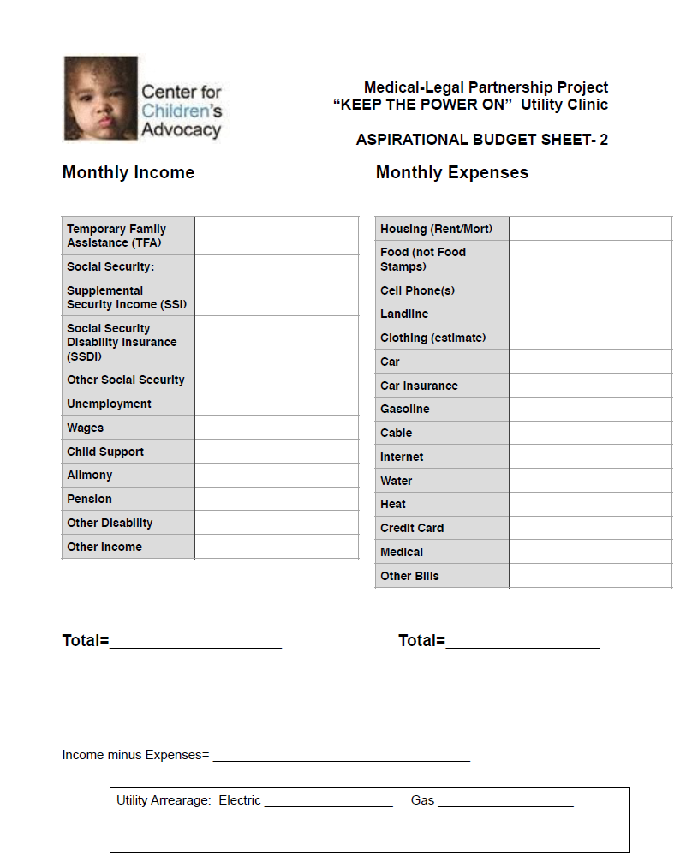
Budget Sheet 2
Aspirational Budget
kidscounsel.org/mlpp
Notes:
ITS THE SAME!
Aspirational situation--> Change Expenses
Foodshare/Foodstamps
Community Resources- 211
Get rid of extra cell phone services
Eliminate landline, Free cell phone from state
Cable changes?
Medicaid- Husky
Income- Expenses: What’s the difference from before?

Slide 21
Budget Counseling Evaluating Expenses
Phone
Evaluate service contract
Necessity of landline
No-cost cell phone programs (211 INFOLINE)
Cable
Evaluate services
Basic Needs
Food, clothing, etc. (211 INFOLINE)
kidscounsel.org/mlpp

Slide 23
Budget Counseling Aspirational Budget
Cost-saving tips generate aspirational budget
Expenses less than income allow for sustainable utility budget

Slide 24
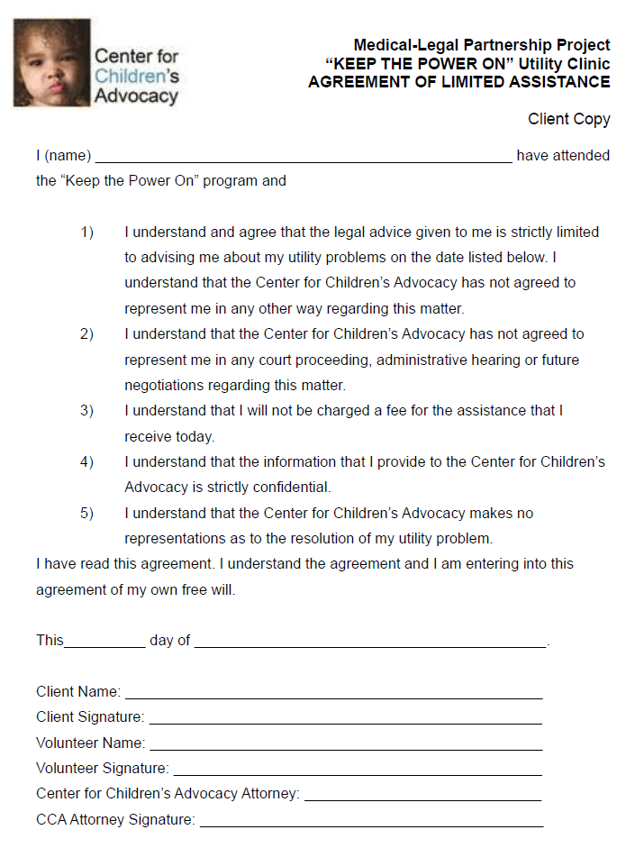
Retainer
Center for Children’s Advocacy Attorney signs here
kidscounsel.org/mlpp

Slide 25
Retainer
Retainer must be signed by
Client
Center for Children’s Advocacy attorney
2 copies of Retainer
Client copy
Center copy
kidscounsel.org/mlpp

Slide 27
Meet with Utility Company
Account information
Payment history
Payment arrangement
Participation in arrearage forgiveness program
kidscounsel.org/mlpp
Notes:
Discuss:
Wait list
goals
Cannot go below average monthly bill for lights
Areas of advocacy
Arrearage forgiveness program
Agreement is ultimately up to client
Do not enter agreement with clients who have zero income and no hope for it in the near future
Black mark on record

Slide 29
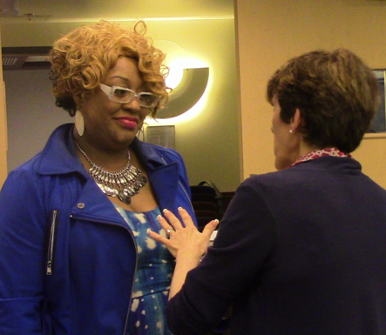
Client Wrap Up
Review arrangement
Stress compliance
Complete 2 Payment Agreement Forms
kidscounsel.org/mlpp

Slide 31
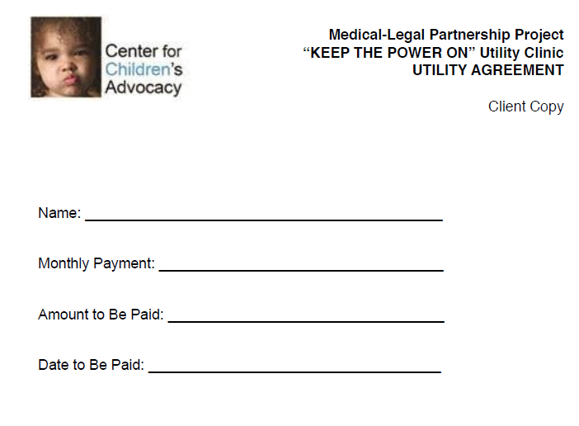
Payment
Agreement
Form
Complete
2 Copies
kidscounsel.org/mlpp

Slide 33
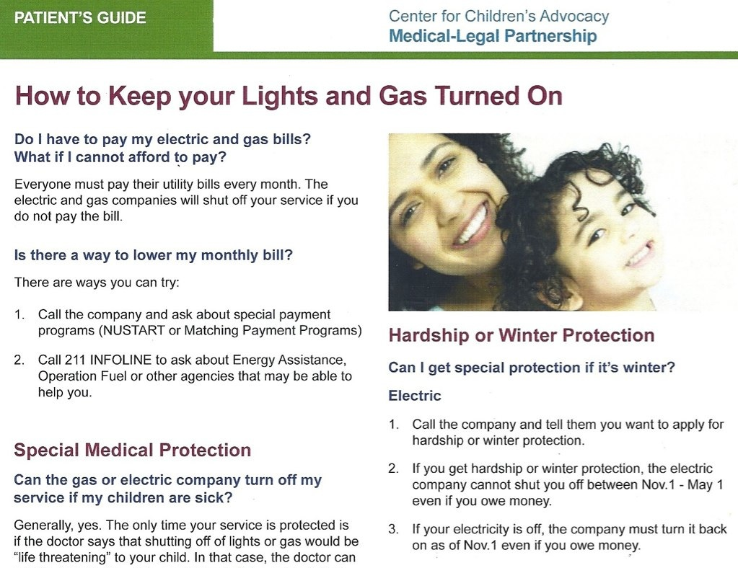
Center for
Children’s
Advocacy
Publications
kidscounsel.org/mlpp
kidscounsel.org/mlpp

Slide 34
Thank You
for funding this video
kidscounsel.org/mlpp

Slide 35
Center for Children’s Advocacy Fighting for the legal rights of Connecticut’s most vulnerable children
Bonnie Roswig
Senior Staff Attorney
Medical-Legal Partnership Project
broswig@connecticutchildrens.org
860-545-8581
kidscounsel.org/mlpp

