Slide 1
Unaccompanied Immigrant Children Past and Current Issues
Edwin D. Colón, Esq, MSW
Center for Children’s Advocacy
Day Pitney
September 29, 2016

Slide 2
Topics
Part I.
Experience of unaccompanied immigrant children
Push factors: significant trauma and unmet needs
U.S. Government response
Response from legal community
kidscounsel.org

Slide 3
Topics
Part II.
Legal relief options for undocumented children
who experienced neglect, abuse or abandonment
Special Immigrant Juvenile Status
Asylum & Convention Against Torture
Human Trafficking Visa Protection
Other forms of relief available to children
kidscounsel.org

Slide 4
Topics
Part II.
Present legal and policy issues impacting unaccompanied immigrant children
Opportunities to learn more and get involved in supporting unaccompanied immigrant children
kidscounsel.org

Slide 5
Part I.
Experience of unaccompanied
immigrant children
kidscounsel.org

Slide 6
Undocumented or Refugee?
Undocumented Child
Foreign-born person who lacks a right to be in the
United States, having either entered without inspection
(and not subsequently obtained any right to remain)
or stayed beyond expiration date of visa or other status.
kidscounsel.org

Slide 7
Undocumented or Refugee?
Refugee Child
Refugee defined as:
outside country of nationality/habitual residence
unable or unwilling to return due to well-founded fear of persecution based on race, religion, nationality, political opinion, or membership in particular social group.
Article 1(A)(2) of 1951 Convention relating to status of refugees
kidscounsel.org
Notes:
Applying this definition, internally displaced persons (IDPs) – including individuals fleeing natural disasters and generalized violence, stateless individuals not outside their country of habitual residence or not facing persecution, and individuals who have crossed an international border fleeing generalized violence are not considered refugees under either the 1951 Convention or the 1967 Optional Protocol.

Slide 8
Unaccompanied Alien Child (UAC)
UAC defined as:
No lawful immigration status in the U.S. and
Has not attained 18 years of age and
No parent or legal guardian in the U.S. or no parent of legal guardian in the U.S. available to provide care and physical custody See 6 U.S.C. §279(g)(2)
kidscounsel.org
Notes:
Applying this definition, internally displaced persons (IDPs) – including individuals fleeing natural disasters and generalized violence, stateless individuals not outside their country of habitual residence or not facing persecution, and individuals who have crossed an international border fleeing generalized violence are not considered refugees under either the 1951 Convention or the 1967 Optional Protocol.

Slide 9
Customs and Border Protection facility, South Texas 2015.
Unidentified immigrants detained after crossing U.S.-Mexico border illegally.
Photo courtesy U.S. Rep Henry Cuellar, D-Laredo. www.theindianpanorama.news/world/unitedstates/border-patrol-gets-new-guidelines-for-immigrant-detentions-48182/
kidscounsel.org
Notes:
Applying this definition, internally displaced persons (IDPs) – including individuals fleeing natural disasters and generalized violence, stateless individuals not outside their country of habitual residence or not facing persecution, and individuals who have crossed an international border fleeing generalized violence are not considered refugees under either the 1951 Convention or the 1967 Optional Protocol.

Slide 10
Flores Settlement Agreement
Litigation began in 1984.
Reached Supreme Court, Reno v. Flores, 507 U.S. 292 (1993)
Court expressly rejected argument that UACs who have no
available parent or guardian have a “fundamental right” to be
placed in custody of willing and able private custodian instead of
government custody.
1997 agreement resolving challenge to certain practices of
(then) Immigration and Naturalization Service (INS) as to
detention of UACs.
Notwithstanding decision, litigation continued, in part, over conditions of detainment; settlement reached.
kidscounsel.org

Slide 11
Flores Settlement Agreement
Establishes:
minors in federal custody treated with “dignity, respect and special concern for particular vulnerability as minors”
procedures for temporary placement of minors following arrest, including expeditious processing
providing minor with notice of rights
generally segregating UACs from unrelated adults
favoring release without unnecessary delay - to parents, legal guardians, adult relatives, certain others, licensed programs willing to accept custody, or under certain conditions, another entity or adult individual, in this order of preference.
kidscounsel.org

Slide 12
UAC Experience
Unaccompanied child apprehended by immigration authorities, transferred to care and custody of
Office of Refugee Resettlement (ORR).
Federal law requires ORR to feed, shelter, and provide medical care until able to release child to safe setting
(usually family members), while awaiting proceedings.
kidscounsel.org

Slide 13
UAC Apprehended by U.S. Border Patrol
Year | Number of UAC
2011 | 16,067
2014 | 68,500
2015 | 39,970 (42% decrease)
2016 | 27, 754 (to date)
See Kandel, William A., Unaccompanied Alien Children: An Overview, Congressional Research Service. May 11, 2016: www.fas.org/sgp/crs/homesec/R43599.pdf
kidscounsel.org

Slide 14
UAC Experience
See Kandel, William A., Unaccompanied Alien Children: An Overview, Congressional
Research Service. May 11, 2016: www.fas.org/sgp/crs/homesec/R43599.pdf
kidscounsel.org
Notes:
El Salvador, Guatemala, Honduras, and Mexico accounted for almost all
UAC cases in recent years, especially in FY2014. In FY2009, Mexico accounted for 82% of the
19,688 UAC apprehensions at the Southwest border, while the other three Central American
countries accounted for 17%. In FY2014, the proportions had almost reversed, with Mexican
nationals comprising 23% of UAC apprehensions and the three Central American countries
comprising 77%. For the first six months of FY2016, Mexican nationals made up 21% of total
UAC apprehensions

Slide 15
UAC Released to Sponsors
State | FY 2014 Oct to Sep | FY2015 Oct to Sep | FY 2016 YTD Oct to July
Connecticut | 552 | 206 | 365
District of Columbia | 375 | 201 | 386
Florida | 5,445 | 2,908 | 4,749
Massachusetts | 1,372 | 738 | 1,369
New Jersey | 2,680 | 1,462 | 2,373
New York | 5,955 | 2,630 | 4,438
Source: ACS, ORR http://www.acf.hhs.gov/programs/orr/programs/ucs/state-by-state-uc-placed-sponsors
kidscounsel.org

Slide 16
Janier
Age 16, from Honduras
As young child, routinely left alone with nothing to eat
No one home to care for him
Worked since age seven in corn and rice fields
Interrupted formal education
Father hit him with machete
Leg swollen and painful, never taken to doctor
kidscounsel.org
Notes:
A revision to the Texas education laws in 1975 allowed the state to withhold from local school districts state funds for educating children of illegal aliens. This case was decided together with Texas v. Certain Named and Unnamed Alien Child. The Court reasoned that illegal aliens and their children, though not citizens of the United States or Texas, are people "in any ordinary sense of the term" and, therefore, are afforded Fourteenth Amendment protections. Since the state law severely disadvantaged the children of illegal aliens, by denying them the right to an education, and because Texas could not prove that the regulation was needed to serve a "compelling state interest," the Court struck down the law.

Slide 17
Janier
Hit with machete again, almost severed thumb
Borrowed money for doctor from neighbors
Earned equivalent of $26.00 a week
Parents took most earnings
Threats from criminal gangs: turn over earnings or face beatings, kidnapping, death
kidscounsel.org
Notes:
A revision to the Texas education laws in 1975 allowed the state to withhold from local school districts state funds for educating children of illegal aliens. This case was decided together with Texas v. Certain Named and Unnamed Alien Child. The Court reasoned that illegal aliens and their children, though not citizens of the United States or Texas, are people "in any ordinary sense of the term" and, therefore, are afforded Fourteenth Amendment protections. Since the state law severely disadvantaged the children of illegal aliens, by denying them the right to an education, and because Texas could not prove that the regulation was needed to serve a "compelling state interest," the Court struck down the law.

Slide 18
Janier
Left Honduras due to abuse, neglect, threats
Walked from Honduras to Mexico
Jumped onto moving trains to get to U.S. border
Begged for water and food
Apprehended at border
Released by ORR to cousin in Stamford, CT
kidscounsel.org
Notes:
A revision to the Texas education laws in 1975 allowed the state to withhold from local school districts state funds for educating children of illegal aliens. This case was decided together with Texas v. Certain Named and Unnamed Alien Child. The Court reasoned that illegal aliens and their children, though not citizens of the United States or Texas, are people "in any ordinary sense of the term" and, therefore, are afforded Fourteenth Amendment protections. Since the state law severely disadvantaged the children of illegal aliens, by denying them the right to an education, and because Texas could not prove that the regulation was needed to serve a "compelling state interest," the Court struck down the law.

Slide 19
Janier’s Complex Needs
Education
Health
Mental Health (trauma)
Legal
kidscounsel.org

Slide 20
What is at Stake?
www.theguardian.com/us-news/2015/oct/12/obama-immigration-deportations-central-america
www.unhcr.org/en-us/news/latest/2015/1/54ca32d89/deported-children-face-deadly-new-dangers-return-honduras.html
kidscounsel.org

Slide 21
U.S. Government Response
2014: Administration developed working group to coordinate efforts of federal agencies involved with UACs
opened additional shelters and holding facilities
funding to affected Central American countries for programs and initiatives to mitigate flow
kidscounsel.org
Notes:
A revision to the Texas education laws in 1975 allowed the state to withhold from local school districts state funds for educating children of illegal aliens. This case was decided together with Texas v. Certain Named and Unnamed Alien Child. The Court reasoned that illegal aliens and their children, though not citizens of the United States or Texas, are people "in any ordinary sense of the term" and, therefore, are afforded Fourteenth Amendment protections. Since the state law severely disadvantaged the children of illegal aliens, by denying them the right to an education, and because Texas could not prove that the regulation was needed to serve a "compelling state interest," the Court struck down the law.

Slide 22
U.S. Government Response
2015: Congress appropriated $3.4 billion for detection, enforcement and removal, including transport for CBP.
Rocket Dockets
DOJ-EOIR Office of Legal Access Programs
Baltimore Representation Initiative for Unaccompanied Children
Legal Orientation Program for Custodians of Unaccompanied Alien Children
kidscounsel.org
Notes:
In 2014, OLAP started a new direct representation pilot program to fund legal representation and other related services for certain unaccompanied children in immigration proceedings before the Baltimore Immigration Court. Staffed by two attorneys, the Baltimore Representation Initiative for Unaccompanied Children (BRIUC) provides legal representation and other related services to unrepresented unaccompanied children who:
Are under the age of 16
Have been released from the custody of the Office of Refugee Resettlement (ORR)
Have been served a Notice to Appear in immigration proceedings, and are currently scheduled to appear before the Baltimore Immigration Court
Have not had their cases consolidated with immigration proceedings against a parent or legal guardian
This representation must be provided regardless of the child’s eligibility for immigration relief.

Slide 23
Legal Community Response
Access to Counsel and Immigration Relief Options
Local Bar Level Efforts
Pro-bono initiatives to address gap in legal representation
Know your Rights presentations in detention
Legal Clinics for families with children while in detention
kidscounsel.org

Slide 24
Legal Community Response
Access to Counsel and Immigration Relief Options
National Efforts
Fair Day in Court for Kids Act Provide UACs with attorneys to guide through complicated immigration court process
F.L.B. v. Lynch (J.E.F.M. v. Holder), No. 2:14-cv-01026 (W.D. Wash. filed July 9, 2014) American Immigration Council et. al. lawsuit seeking recognition of right to appointed counsel for unrepresented children in immigration proceedings
kidscounsel.org
Notes:
Ongoing before the U.S. District Court for the Western District of Washington, while certain jurisdictional issues are before the Ninth Circuit Court of Appeals on interlocutory appeal

Slide 25
Part II.
Legal relief options for undocumented children who experienced neglect, abuse or abandonment.
kidscounsel.org

Slide 26
Special Immigrant Juvenile Status (SIJS)
Two part process regularizes immigration status to protect abandoned, abused or neglected children
Pursuant to guardianship or child abuse/neglect proceeding, state court makes specific findings as to immigrant child
Child uses state court order to apply for federal SIJS protection
kidscounsel.org

Slide 27
SIJS
Important!
State court order does not grant immigration benefit (prerequisite allows child to apply for benefit)
SIJS cannot be obtained solely to avoid removal from U.S.
kidscounsel.org

Slide 28
Eligibility for SIJS
All of these must be true
Under age twenty-one
Unmarried
Dependent upon court or in custody of state agency
Returning to live with one or both parents not viable due to abuse, neglect, abandonment
Not in best interest to return to country of origin
kidscounsel.org

Slide 29
Statutory Authority
Immigration and Nationality Act § 101(a)(27)(J), codified at 8 USC § 1101(a)(27)(J)
Statute implemented by standards in federal regulations Code of Federal Regulation at 8 CFR § 204.11
Regulations not yet updated to reflect changes made to underlying SIJ statute Amended in 2008 by Trafficking Victims Protection and Reauthorization Act (TVPRA) of 2008, Pub. L. No. 110‐457, 122 Stat. 5044
kidscounsel.org

Slide 30
Visa Bulletin Clarification for SIJ
April 2016 (U.S. State Dept. Bulletin for May 2016)
Visa category for El Salvador, Guatemala, Honduras oversubscribed. USCIS
will stop accepting status adjustment (green card) applications.
April 15, 2016
USCIS clarified, will hold remainder of April 2016 filings in abeyance until
adjudication possible. After May 1, 2016, will accept only new applications with
priority date before Jan 1, 2010.
Effective October 1, 2016 Adjustment of status applications on behalf of Special Immigrant Juveniles born
in El Salvador, Guatemala or Honduras can be adjudicated if and only if the
applicant has a “priority date” earlier than June 15, 2015.
kidscounsel.org

Slide 31
SIJ State Specific Statutes, Case Law
State | Statute or Case | Summary
Connecticut | Conn. Gen. Stat. § 45a-608n-o | Codifies federal SIJ statute into Connecticut law. State jurisdiction ends at age 18.
Massachusetts | Recinos v. Escobar, 46 N.E.3d 60 (Mass. 2016) | Extends jurisdiction of Probate and Family Court under its equity power to make SIJ findings for youth between ages of 18-21.
New York | Family Court Act § 661(a) | Extends jurisdiction of family court to adjudicate petitions for person “…who is less than 21 years old who consents to appointment or continuation of guardian after age of 18.”
kidscounsel.org

Slide 32
Important!
Only need finding that reunification with
one parent is not viable
Definition of minor child
Limits juvenile and probate court jurisdiction to person under 18 years of age
Up to age 21 for USCIS final SIJS determination
kidscounsel.org

Slide 33
Perez-Olano Enforcement Action
Applicant otherwise eligible will remain eligible even if he/she:
Turns 21 after filing SIJ petition (Form I-360) but prior to USCIS decision on SIJ petition, and/or
Ages out of juvenile jurisdiction prior to filing SIJ petition
See USCIS Policy Memorandum 602-0117: www.uscis.gov/sites/default/files/USCIS/Laws/Memoranda/2015/2015-0624_Perez-Olano_Settlement_Agreement_PM_Effective.pdf
kidscounsel.org

Slide 34
Asylum
Confers legal status and ability to apply for work authorization, permanent residence, citizenship.
Often pursued with Convention Against Torture and/or Withholding of Removal Petition
Must be refugee
No longer in country of origin
Suffered past persecution, or
Well-founded fear of future persecution due to race, religion, nationality, political opinion, member of particular social group (gender, sexuality, forced marriage, FGM, etc.)
Government unable or unwilling to provide protection
kidscounsel.org

Slide 35
Asylum
Must not have bars to asylum eligibility
Must apply for asylum within one year of last entry Exceptions: extraordinary or changed circumstances, minor child when entered
Firm Resettlement: must not have offer of residence or citizenship from another country.
Must not have felony or other serious criminal conviction
kidscounsel.org

Slide 36
T-Visa
Must be noncitizen victim of severe form of trafficking
Sex Trafficking Commercial sex induced by force, fraud, coercion, or individual under age 18
Labor Trafficking Recruitment, harboring, transportation, provision, or obtaining person for labor through force, fraud, coercion or purpose of subjection to involuntary servitude, peonage, debt bondage, slavery
Must be physically present in U.S. on account of such trafficking
Does not have to establish that this is why came to U.S.
Must show that this is why still in U.S.
kidscounsel.org

Slide 37
T-Visa
Must cooperate with authorities investigating or prosecuting trafficking, comply with reasonable requests or
Cannot cooperate due to physical/psychological trauma or
17 or younger
Must show extreme hardship involving unusual and severe harm
upon removal. Cannot be based on current/future economic
detriment or lack of social/economic opportunities.
kidscounsel.org

Slide 38
Other Forms of Immigration Relief
DACA
Discretionary relief for certain undocumented young people who came to U.S. as children and pursued education or military service.
VAWA
Individuals with close family relationships to abusive U.S.
citizens/lawful permanent residents petition for status without
support of abusive family member.
U-Visa
Noncitizen victims of certain criminal activities.
kidscounsel.org

Slide 39
Enforcement Priorities
Priority Level 1 (highest)
Convicted of felony or aggravated felony Element of participation in criminal gang, or 16 or older and intentionally participated in criminal gang
Involved in or suspected of terrorism or espionage, or otherwise pose danger to national security
Apprehended at border or port of entry attempting to enter unlawfully
See DHS Policies for Apprehension, Detention and Removal of Undocumented Immigrants, November 20, 2014: www.dhs.gov/sites/default/files/publications/14_1120_memo_prosecutorial_discretion.pdf
kidscounsel.org

Slide 40
Enforcement Priorities
Priority Level 2 (medium)
Convicted of significant misdemeanor or 3 or more non‐significant misdemeanors
Entered or reentered U.S. unlawfully and cannot establish continuous physical presence since January 1, 2014
Significantly abused visa or visa waiver programs
kidscounsel.org

Slide 41
Enforcement Priorities
Priority Level 3 (low)
Deportation order issued since January 1, 2014
kidscounsel.org

Slide 42
Immigration Raids
Know Your Rights:
ICE Home Raids and Community Arrests
Immigrant Defense Project
www.immdefense.org/ice-home-and-community-arrests/
Info uncovered during review of the application or during an interview, or
Info obtained through a background check
Juvenile/crimin al records (e.g., gang databases)
Info disclosed on an immigration application
kidscounsel.org

Slide 43
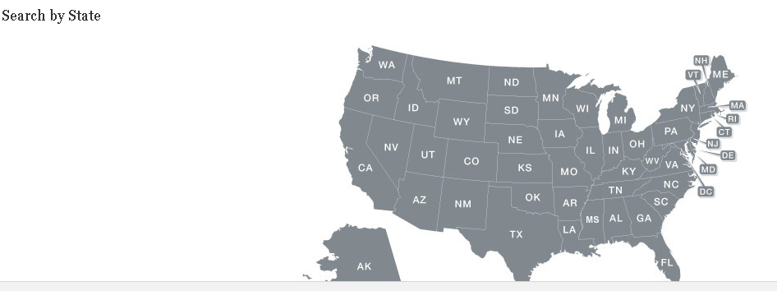
Opportunities to Get Involved
Juvenile/crimin al records (e.g., gang databases)
www.immigrationadvocates.org/probono/volunteer/
kidscounsel.org

Slide 44
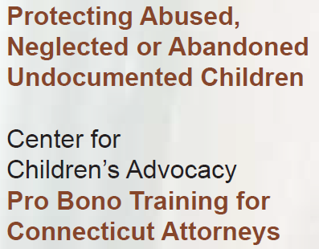
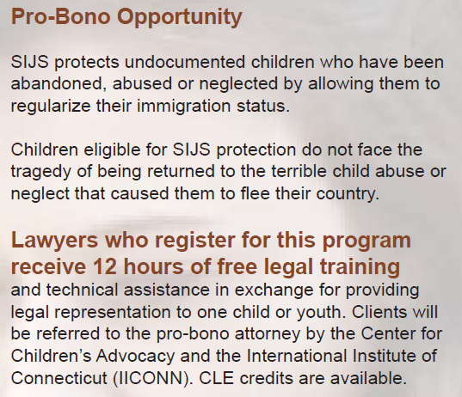
Center for Children’s Advocacy
kidscounsel.org

Slide 45
Questions or Comments?
kidscounsel.org

Slide 46
Connecticut-Specific Resources
Center for Children’s Advocacy kidscounsel.org
International Institute of Connecticut iiconn.org
UCONN School of Law
Asylum & Human Rights Clinic
law.uconn.edu
Click ‘academics’ then ‘clinics’
Esperanza Center for Law and Advocacy
facebook.com/esperanzalaw
Connecticut Legal Services
connlegalservices.org
New Haven Legal Assistance
nhlegal.org
kidscounsel.org

Slide 47
Connecticut-Specific Resources
Integrated Refugee & Immigration Services irisct.org
Spanish Community of Wallingford scowinc.org
Unidad Latina en Acción
ulanewhaven.org
New Haven Trauma Coalition | Clifford Beers Clinic
cliffordbeers.org/new-haven-trauma-coalition-2/
CT Students for a Dream
ct4adream.org
The Community Foundation of Greater New Haven
cfgnh.org
kidscounsel.org

Slide 48
National Resources
Immigrant Legal Resource Center
ilrc.org and click ‘info on immigration law’ then ‘remedies . .’
ilrc.org/resources/unaccompanied-immigrant-children-resources
U.S. Committee for Refugees and Immigrants
refugees.org/resources/for-lawyers/special-immigrant-juvenile-status
ATLAS DIY findingatlas.wordpress.com
U.S. Committee for Refugees and Immigrants refugees.org/resources/for-lawyers
kidscounsel.org

Slide 49
National Resources
Immigration Advocates Network
https://www.immigrationadvocates.org/probono/volunteer/
kidscounsel.org

Slide 50
Attorney Edwin D. Colón
ecolon@kidscounsel.org
203-335-0719
kidscounsel.org

